Slide 1
Processes Management
Process Concept
Process Scheduling
Operations on Processes
Cooperating Processes
Interprocess Communication
Communication in Client-Server Systems
Operating System Concepts

Slide 2
Process Concept
An operating system executes a variety of programs:
  Batch system – jobs
  Time-shared systems – user programs or tasks
Textbook uses the terms job and process almost interchangeably.
Process – a program in execution; process execution must progress in sequential fashion.
A process includes:
  program counter
  stack
  data section
Operating System Concepts

Slide 3
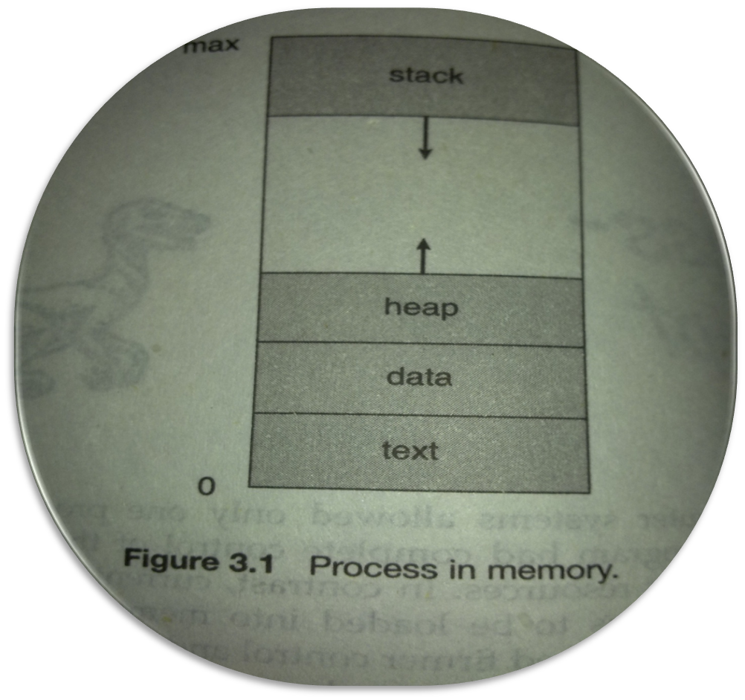
Process Concept
Operating System Concepts

Slide 4
Process State
As a process executes, it changes state
  new: The process is being created.
  running: Instructions are being executed.
  waiting: The process is waiting for some event to occur.
  ready: The process is waiting to be assigned to a processor.
  terminated: The process has finished execution.
Operating System Concepts

Slide 5

Diagram of Process State
Operating System Concepts

Slide 6
Process Control Block (PCB)
Information associated with each process.
Process state
Program counter
CPU registers
CPU scheduling information
Memory-management information
Accounting information
I/O status information
Operating System Concepts

Slide 7

Process Control Block (PCB)
Operating System Concepts

Slide 8
Context Switching
Switching the CPU to another process requires a state save of the current process and a state restore of a different process. This task is known as context switching.
The Context of a process is saved in PCB.
Context Switching time is pure overhead.
Its speed varies from machine to machine depending upon memory speed and the number of register.
Operating System Concepts

Slide 9

CPU Switch From Process to Process
Operating System Concepts

Slide 10
Process Scheduling Queues
Job queue – set of all processes in the system.
Ready queue – set of all processes residing in main memory, ready and waiting to execute.
Device queues – set of processes waiting for an I/O device.
All the queues are implemented by linked list.
Each queue has a header contains pointers to the first and final PCBs.
In turn each PCB includes a pointer field that points to the next PCB
Process migration between the various queues.
Operating System Concepts

Slide 11

Ready Queue And Various I/O Device Queues
Operating System Concepts

Slide 12

Representation of Process Scheduling
Operating System Concepts

Slide 13
Schedulers
Long-term scheduler (or job scheduler) – selects which processes should be brought into the ready queue.
Short-term scheduler (or CPU scheduler) – selects which process should be executed next and allocates CPU.
Operating System Concepts

Slide 14
Schedulers (Cont.)
Short-term scheduler is invoked very frequently (milliseconds) ⇒ (must be fast).
Long-term scheduler is invoked very infrequently (seconds, minutes) ⇒ (may be slow).
The long-term scheduler controls the degree of multiprogramming.
Processes can be described as either:
  I/O-bound process – spends more time doing I/O than computations, many short CPU bursts.
  CPU-bound process – spends more time doing computations; few very long CPU bursts.
Operating System Concepts

Slide 15

Addition of Medium Term Scheduling
Operating System Concepts

Slide 16
Process Creation
Parent process create children processes, which, in turn create other processes, forming a tree of processes.
Resource sharing
  Parent and children share all resources.
  Children share subset of parent’s resources.
  Parent and child share no resources.
Execution
  Parent and children execute concurrently.
  Parent waits until children terminate.
Operating System Concepts

Slide 17
Process Creation (Cont.)
Address space
  Child duplicate of parent.
  Child has a program loaded into it.
UNIX examples
  fork system call creates new process
  exec system call used after a fork to replace the process’ memory space with a new program.
Operating System Concepts

Slide 18

Processes Tree on a UNIX System
Operating System Concepts

Slide 19
Process Termination
Process executes last statement and asks the operating system to delete it (exit).
  Output data from child to parent (via wait).
  Process’ resources are deallocated by operating system.
Parent may terminate execution of children processes (abort).
  Child has exceeded allocated resources.
  Task assigned to child is no longer required.
  Parent is exiting.
    Operating system does not allow child to continue if its parent terminates.
    Cascading termination.
Operating System Concepts

Slide 20
Interprocess Communication (IPC)
Cooperating Processes:
Independent process cannot affect or be affected by the execution of another process.
Cooperating process can affect or be affected by the execution of another process
Advantages of process cooperation
  Information sharing
  Computation speed-up
  Modularity
  Convenience
Operating System Concepts

Slide 21
Producer-Consumer Problem
Shared-Memory System
Paradigm for cooperating processes, producer process produces information that is consumed by a consumer process.
  unbounded-buffer places no practical limit on the size of the buffer.
  bounded-buffer assumes that there is a fixed buffer size.
Operating System Concepts

Slide 22
Bounded-Buffer – Shared-Memory Solution
Shared data
      #define BUFFER_SIZE 10
      Typedef struct {
      . . .
      } item;
      item buffer[BUFFER_SIZE];
      int in = 0;
      int out = 0;
      in points to the next free position
      out points to the first full position
      In==out (buffer is empty)
      ((in +1)%BUFFER_SIZE))==out(buffer full)
Solution is correct, but can only use BUFFER_SIZE-1 elements
Operating System Concepts

Slide 23
Bounded-Buffer – Producer Process
item nextProduced;
while (1) {
while (((in + 1) % BUFFER_SIZE) == out)
; /* do nothing */
buffer[in] = nextProduced;
in = (in + 1) % BUFFER_SIZE;
}
Operating System Concepts

Slide 24
Bounded-Buffer – Consumer Process
item nextConsumed;
while (1) {
while (in == out)
; /* do nothing */
nextConsumed = buffer[out];
out = (out + 1) % BUFFER_SIZE;
}
Operating System Concepts

Slide 25
Message Passing Systems
Mechanism for processes to communicate and to synchronize their actions without sharing memory.
Message system – processes communicate with each other without resorting to shared variables.
IPC facility provides two operations:
  send(message) – message size fixed or variable
  receive(message)
If P and Q wish to communicate, they need to:
  establish a communication link between them
  exchange messages via send/receive
Implementation of communication link
  physical (e.g., shared memory, hardware bus)
  logical (e.g., logical properties)
Operating System Concepts

Slide 26
Implementation Questions
How are links established?
Can a link be associated with more than two processes?
How many links can there be between every pair of communicating processes?
What is the capacity of a link?
Is the size of a message that the link can accommodate fixed or variable?
Is a link unidirectional or bi-directional?
Operating System Concepts

Slide 27
Direct Communication
Processes must name each other explicitly:
  send (P, message) – send a message to process P
  receive(Q, message) – receive a message from process Q
Properties of communication link
  Links are established automatically.
  A link is associated with exactly one pair of communicating processes.
  Between each pair there exists exactly one link.
  The link may be unidirectional, but is usually bi-directional.
Operating System Concepts

Slide 28
Indirect Communication
Messages are directed and received from mailboxes (also referred to as ports).
  Each mailbox has a unique id.
  Processes can communicate only if they share a mailbox.
Properties of communication link
  Link established only if processes share a common mailbox
  A link may be associated with many processes.
  Each pair of processes may share several communication links.
  Link may be unidirectional or bi-directional.
Operating System Concepts

Slide 29
Indirect Communication
Operations
  create a new mailbox
  send and receive messages through mailbox
  destroy a mailbox
Primitives are defined as:
send(A, message) – send a message to mailbox A
receive(A, message) – receive a message from mailbox A
Operating System Concepts

Slide 30
Indirect Communication
Mailbox sharing
  P₁, P₂, and P₃ share mailbox A.
  P₁, sends; P₂ and P₃ receive.
  Who gets the message?
Solutions
  Allow a link to be associated with at most two processes.
  Allow only one process at a time to execute a receive operation.
  Allow the system to select arbitrarily the receiver. Sender is notified who the receiver was.
Operating System Concepts

Slide 31
Synchronization
Message passing may be either blocking or non-blocking.
Blocking is considered synchronous
Non-blocking is considered asynchronous
send and receive primitives may be either blocking or non-blocking.
Operating System Concepts

Slide 32
Buffering
Queue of messages attached to the link; implemented in one of three ways.
  1. Zero capacity – 0 messages
  Sender must wait for receiver (rendezvous).
  2. Bounded capacity – finite length of n messages
  Sender must wait if link full.
  3. Unbounded capacity – infinite length
  Sender never waits.
Operating System Concepts

Slide 33
Threads
A thread is a basic unit of CPU utilization; it comprises a thread ID, a register set, and a stack.
The thread shares its code section , data section, and other resources with other threads belongs to the same process.
A heavyweight process has a single thread of control but a lightweight process has multiple threads of control.
Example : A word processor may have a thread for displaying graphics, another thread for responding key strokes from the user and a third thread for performing spelling and grammar checking in the back ground.
Operating System Concepts

Slide 34

Single and Multithreaded Processes
Operating System Concepts

Slide 35
Benefits
Responsiveness
Resource Sharing
Economy
Utilization of MP Architectures
Operating System Concepts

Slide 36
User Threads
Thread management done by user-level threads library
A user thread is normally created by a threading library and scheduling is managed by the threading library itself (Which runs in user mode). All user threads belong to process that created them.
The advantage of user threads is that they are portable.
Examples
- POSIX Pthreads
- Mach C-threads
- Solaris threads
Operating System Concepts

Slide 37
Kernel Threads
Supported by the Kernel
A kernel thread is created and scheduled by the kernel. Kernel threads are often more expensive to create than user threads and the system calls to directly create kernel threads are very platform specific.
Examples
- Windows 95/98/NT/2000
- Solaris
- Tru64 UNIX
- BeOS
- Linux
Operating System Concepts

Slide 38
Multithreading Models
Many-to-One
One-to-One
Many-to-Many
Operating System Concepts

Slide 39
Many-to-One
Many user-level threads mapped to single kernel thread.
Thread management is done by the thread library in user space.
It is efficient
Multiple threads are unable to run in parallel on multiprocessor because only one thread can access the kernel at a time.
Used on systems that do not support kernel threads.
Operating System Concepts

Slide 40

Many-to-One Model
Operating System Concepts

Slide 41
One-to-One
Each user-level thread maps to kernel thread.
It provides more concurrency than many-to-one model
The drawback of this model is to create a kernel thread for each user thread . This is a overhead.
Examples
- Windows 95/98/NT/2000
- OS/2
Operating System Concepts

Slide 42

One-to-one Model
Operating System Concepts

Slide 43
Many-to-Many Model
Allows many user level threads to be mapped to many kernel threads.
Allows the operating system to create a sufficient number of kernel threads.
Solaris 2
Windows NT/2000 with the ThreadFiber package
Operating System Concepts

Slide 44

Many-to-Many Model
Operating System Concepts

Slide 45
Threading Issues
Semantics of fork() and exec() system calls.
Create a new thread or duplicate the process with all thread.
Thread cancellation
Asynchronous or Deferred
Signal handling
Synchronous and Asynchronous signal may be handled by default signal handler or user-defined signal handler.
Thread pools
A thread pool limits the number of threads that exist at one point.
Thread specific data
Though the all the thread share the data , however in some circumstance each thread might need its own copy of certain data. We call such data thread specific data.
Operating System Concepts

Slide 46
Process or CPU Scheduling
Maximum CPU utilization obtained with multiprogramming
CPU–I/O Burst Cycle – Process execution consists of a cycle of CPU execution and I/O wait.
CPU burst distribution
Operating System Concepts

Slide 47

Alternating Sequence of CPU And I/O Bursts
Operating System Concepts

Slide 48

Histogram of CPU-burst Times
Operating System Concepts

Slide 49
CPU Scheduler
Selects from among the processes in memory that are ready to execute, and allocates the CPU to one of them.
CPU scheduling decisions may take place when a process:
  1. Switches from running to waiting state.
  2. Switches from running to ready state.
  3. Switches from waiting to ready.
  4. Terminates.
Scheduling under 1 and 4 is nonpreemptive.
All other scheduling is preemptive.
Operating System Concepts

Slide 50
Criteria for Judge Best Algorithm
CPU utilization – keep the CPU as busy as possible
Throughput – The number of processes that complete their execution per time unit
Turnaround time – amount of time to execute a particular process
Waiting time – amount of time a process has been waiting in the ready queue
Response time – amount of time it takes from when a request was submitted until the first response is produced, not output (for time-sharing environment)
Operating System Concepts

Slide 51
Optimization Criteria
Max CPU utilization
Max throughput
Min turnaround time
Min waiting time
Min response time
Operating System Concepts

Slide 52
First-Come, First-Served (FCFS) Scheduling
Process Burst Time
P₁ 24
P₂ 3
P₃ 3
Suppose that the processes arrive in the order: P₁ , P₂ , P₃
The Gantt Chart for the schedule is:
Waiting time for P₁ = 0; P₂ = 24; P₃ = 27
Average waiting time: (0 + 24 + 27)/3 = 17
Implemented by FIFO queue.
P₁
P₂
P₃
0
24
27
30
Operating System Concepts

Slide 53
FCFS Scheduling (Cont.)
Suppose that the processes arrive in the order
P₂ , P₃ , P₁ .
The Gantt chart for the schedule is:
Waiting time for P₁ = 6; P₂ = 0; P₃ = 3
Average waiting time: (6 + 0 + 3)/3 = 3
Much better than previous case.
Convoy effect short process behind long process
This is a nonpreemptive algorithm.
P₂
P₃
P₁
0
3
6
30
Operating System Concepts

Slide 54
Shortest-Job-First (SJF) Scheduling
Associate with each process the length of its next CPU burst. Use these lengths to schedule the process with the shortest time.
Two schemes:
  nonpreemptive – once CPU given to the process it cannot be preempted until completes its CPU burst.
  preemptive – if a new process arrives with CPU burst length less than remaining time of current executing process, preempt. This scheme is know as the
  Shortest-Remaining-Time-First (SRTF).
SJF is optimal – gives minimum average waiting time for a given set of processes.
Operating System Concepts

Slide 55
Example of Non-Preemptive SJF
Process Arrival Time Burst Time
P₁ 0.0 7
P₂ 2.0 4
P₃ 4.0 1
P₄ 5.0 4
SJF (non-preemptive)
Average waiting time = (0 + 6 + 3 + 7)/4 = 4
P₁
P₃
P₂
P₄
0
3
7
8
12
16
Operating System Concepts

Slide 56
Example of Preemptive SJF
Process Arrival Time Burst Time
P₁ 0.0 7
P₂ 2.0 4
P₃ 4.0 1
P₄ 5.0 4
SJF (preemptive)
Average waiting time = (9 + 1 + 0 +2)/4 = 3
P₁
P₂
P₃
P₂
P₄
P₁
0
2
4
5
7
11
16
Operating System Concepts

Slide 57
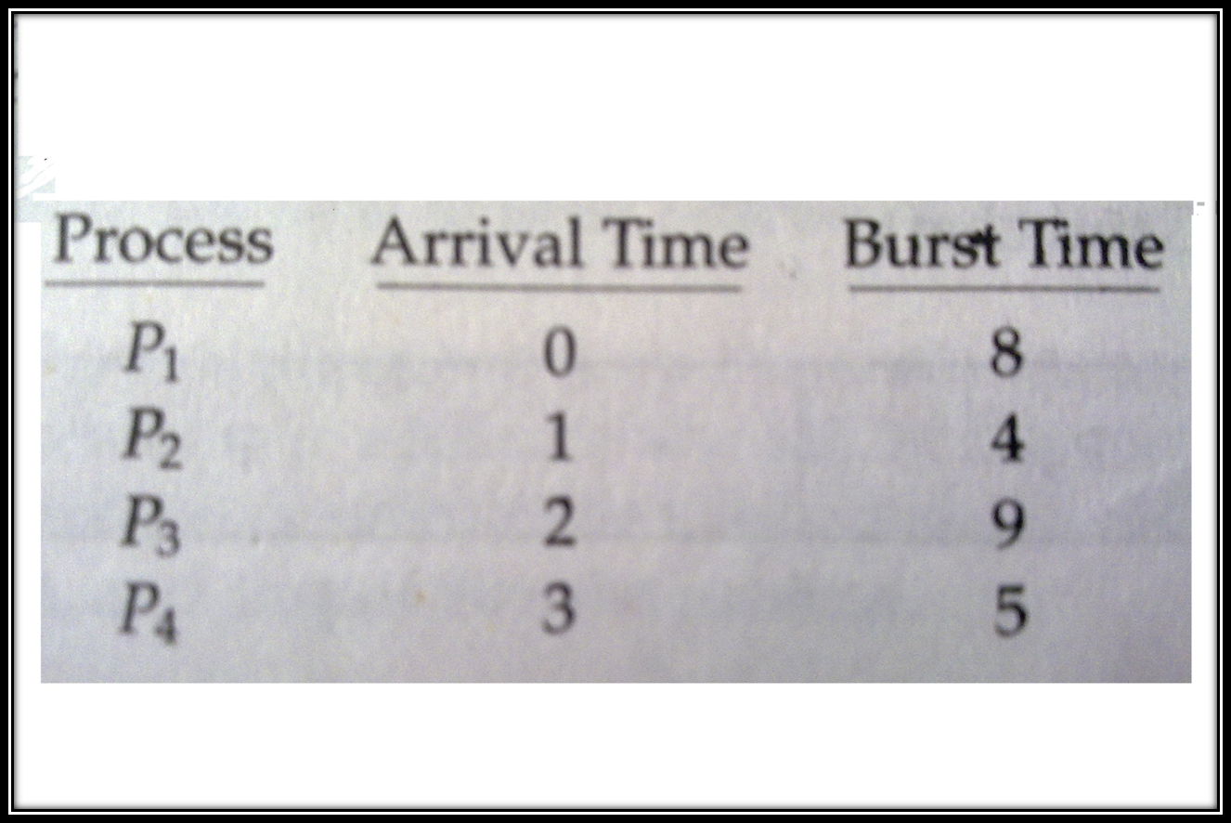
Example of Preemptive SJF
Operating System Concepts

Slide 58
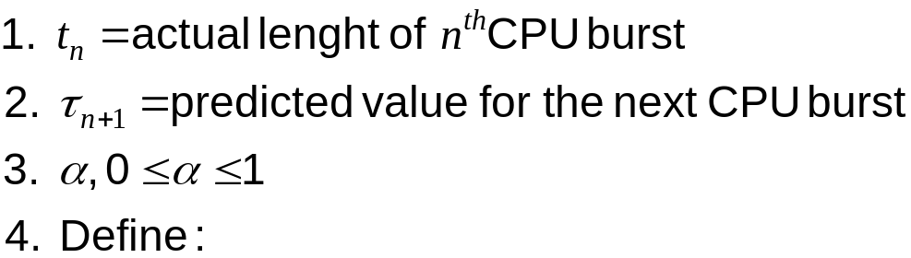

Determining Length of Next CPU Burst
Can only estimate the length.
Can be done by using the length of previous CPU bursts, using exponential averaging.
Operating System Concepts

Slide 59

Prediction of the Length of the Next CPU Burst
Operating System Concepts

Slide 60
Examples of Exponential Averaging
α =0
  τ_{n+1} = τ_{n}
  Recent history does not count.
α =1
  τ_{n+1} = t_{n}
  Only the actual last CPU burst counts.
If we expand the formula, we get:
    τ_{n+1} = α t_{n}+(1 - α) α t_{n-1} + …
    +(1 - α )^{j} α t_{n-j} + …
    +(1 - α )^{n+1} τ₀
Since both α and (1 - α) are less than or equal to 1, each successive term has less weight than its predecessor.
Operating System Concepts

Slide 61
Priority Scheduling
A priority number (integer) is associated with each process
The CPU is allocated to the process with the highest priority (smallest integer ≡ highest priority).
  Preemptive
  Non-preemptive
SJF is a priority scheduling where priority is the predicted next CPU burst time.
Problem ≡ Starvation – low priority processes may never execute.
Solution ≡ Aging – as time progresses increase the priority of the process.
Rumor has it that, when he shut down the IBM 7094 at MIT in 1973, he found a low-priority process that had been submitted in 1967 and had not yet been run.
Operating System Concepts

Slide 62
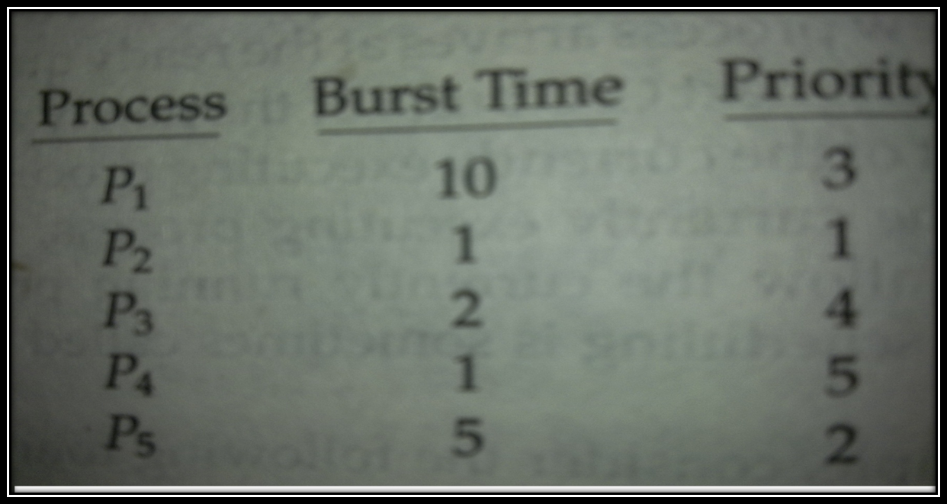
Priority Scheduling
Operating System Concepts

Slide 63
Round Robin (RR)
It is designed for time sharing system. It is similar to FCFS but preemption is added.
A small unit of time, called time quantum is defined.
The ready queue is treated as circular queue.
The scheduler goes around the ready queue, allocating the CPU to each process for a 1 time quantum.
After this time has elapsed, the process is preempted and added to the end of the ready queue.
Performance
  q large ⇒ FIFO
  q small ⇒ q must be large with respect to context switch, otherwise overhead is too high.
Operating System Concepts

Slide 64
Example of RR with Time Quantum = 20
Process Burst Time
P₁ 53
P₂ 17
P₃ 68
P₄ 24
The Gantt chart is:
Typically, higher average turnaround than SJF, but better response.
P₁
P₂
P₃
P₄
P₁
P₃
P₄
P₁
P₃
P₃
0
20
37
57
77
97
117
121
134
154
162
Operating System Concepts

Slide 65

Time Quantum and Context Switch Time
Operating System Concepts

Slide 66
Multilevel Queue
Ready queue is partitioned into separate queues:
foreground (interactive)
background (batch)
Each queue has its own scheduling algorithm,
foreground – RR
background – FCFS
Scheduling must be done between the queues.
  Fixed priority preemptive scheduling; (i.e., serve all from foreground then from background). Possibility of starvation.
  Time slice – each queue gets a certain amount of CPU time which it can schedule amongst its processes;
Operating System Concepts

Slide 67

Multilevel Queue Scheduling
Operating System Concepts

Slide 68
Multilevel Feedback Queue
A process can move between the various queues; aging can be implemented this way.
Multilevel-feedback-queue scheduler defined by the following parameters:
  number of queues
  scheduling algorithms for each queue
  method used to determine when to upgrade a process
  method used to determine when to demote a process
  method used to determine which queue a process will enter when that process needs service
Operating System Concepts

Slide 69
Example of Multilevel Feedback Queue
Three queues:
  Q₀ – time quantum 8 milliseconds
  Q₁ – time quantum 16 milliseconds
  Q₂ – FCFS
Scheduling
  A new job enters queue Q₀ . When it gains CPU, job receives 8 milliseconds. If it does not finish in 8 milliseconds, job is moved to queue Q₁.
  At Q₁ job is again served and receives 16 additional milliseconds. If it still does not complete, it is preempted and moved to queue Q₂.
Operating System Concepts

Slide 70

Multilevel Feedback Queues
Operating System Concepts

